Slide 1

Adaptive Cards
Community Call
Action.ToggleVisibility Deprecation❗
Adaptive Cards Handle Responses Connector in GA🎉
React Native Adaptive Cards Renderer🔜
Q&A ❔
J.P. Roca Microsoft
July 14, 2022

Slide 2
Action.ToggleVisibility Deprecation

Slide 3
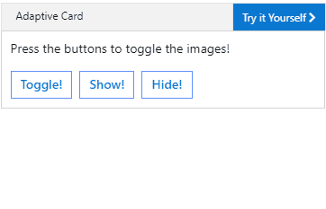
What is Action.ToggleVisibility?
Introduced in schema 1.2
Toggles the visibility of associated card elements

Slide 4
Why are we deprecating Action.ToggleVisibility?
Not accessible by screen narrators
Large number of bugs opened each month
Fixing would require major re-write

Slide 5
What will change after deprecating Action.ToggleVisibility?
Documentation will be updated
Action.ToggleVisibility will not receive future updates
Existing and future implementations will continue to work as expected

Slide 6
How will this impact card authors?
If you currently use Action.ToggleVisibility everything will continue to work as it has in the past
You will still be able to use Action.ToggleVisibility
Card authors should be aware that this action is not accessible to all users
Formality change

Slide 7
What is the path forward?
Team will be working on a proper expander control that meets accessibility requirements
This control will need to function as a true expander and not only simulate its behavior
Will be recommended implementation
ETA for this work is TBD
You can help prioritize by heading over to issue #7678 on our GitHub Repo

Slide 8
What is the path forward?
Team will be working on a proper expander control that meets accessibility requirements
This control will need to function as a true expander and not only simulate its behavior
Will be recommended implementation
ETA for this work is TBD
You can help prioritize by heading over to issue #7678 on our GitHub Repo

Slide 9
Adaptive Cards Handle Responses Connector

Slide 10
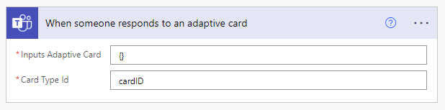
Adaptive Cards Handle Responses Connector
Released into production 🎉
Blog post coming soon
Try it at flow.microsoft.com
Find documentation here: Microsoft Teams - Connectors | Microsoft Docs

Slide 11
React Native Adaptive Cards Renderer

Slide 12



React Native Adaptive Cards Renderer
Developed and maintained by BigThinkCode
Used in MS Viva Connections app
Joining us next month
Vasanth

Slide 13
Q&A

Slide 14
Resources
Let us know the features you need https://aka.ms/ACRoadmap
Get started with Templating https://aka.ms/ACTemplating
Browse the Adaptive Cards Code https://aka.ms/ACRepo
Find tools, sample cards and more https://www.madewithcards.io

Slide 15
Microsoft 365 developer community calls
Adaptive Cards (monthly) https://aka.ms/adaptivecardscommunitycall
Microsoft identity platform (monthly) https://aka.ms/IDDevCommunityCalendar
Office Add-ins (monthly) https://aka.ms/officeaddinscommunitycall
Power Platform (monthly) https://aka.ms/PowerPlatformCommunityCall
Microsoft 365 and Power Platform community (bi-weekly) https://aka.ms/m365-dev-sig
Viva Connections & SharePoint Framework (bi-weekly) https://aka.ms/spfx-call
Microsoft 365 platform (weekly) https://aka.ms/m365-dev-call
(Notice. This call is on a summer break between July 1st and 31st of August 2022)
Download recurrent invites from
https://aka.ms/m365/calls
Notes:
m365-dev-sig

Slide 16
Thank you
Recording will be available on
Microsoft 365 Community (PnP) YouTube channel
https://aka.ms/M365PnP/videos
(subscribe today)
Follow us on Twitter
@Microsoft365Dev | @M365PnP
Next Adaptive Cards community call: August 11th at 09:00am PT
All available community calls from https://aka.ms/m365pnp

